Slide 1
PROFESSIONAL MAINTENANCE APPLICATION V.1.0 (Smart Maintenance App)
Product Backlog - Sprint Backlog - High level architecture
Group 15:
BIFULCO GIUSEPPE GERARDO
ESPOSITO SABATINO
GIGLIO IVAN
BOLVINO ANGELO RAFFAELE

Slide 2



Roles
Initially, the roles were defined as follows:
Product Owner: Bifulco Giuseppe Gerardo;
Scrum Master: Esposito Sabatino;
Subsequently, the roles were assigned in rotation.
Product Owner
Scrum Master
The Team

Slide 3
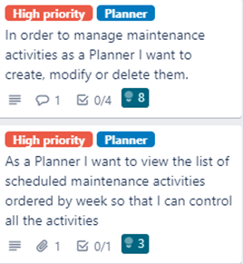
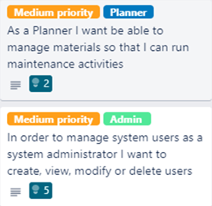
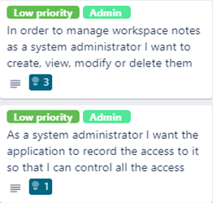
Product Backlog
To create the product backlog we decided to define user stories based on the requirements provided in the document PM SRS Part I – Planner
The order of priorities for the various user stories has been defined as follows:
High priority level :
Medium priority level :
Low priority level :
The highest priority was assigned to the user stories able to give the greatest value to the customer at the first release. In this case, the highest priority goes to maintenance management (Planner);
A qualitative analysis was made to assign a number of story points to each user story.
For the first sprint we assumed to be able to consume 25 story points.
Click the link to visit Trello page: https://trello.com/b/lv27Id83/project

Slide 4
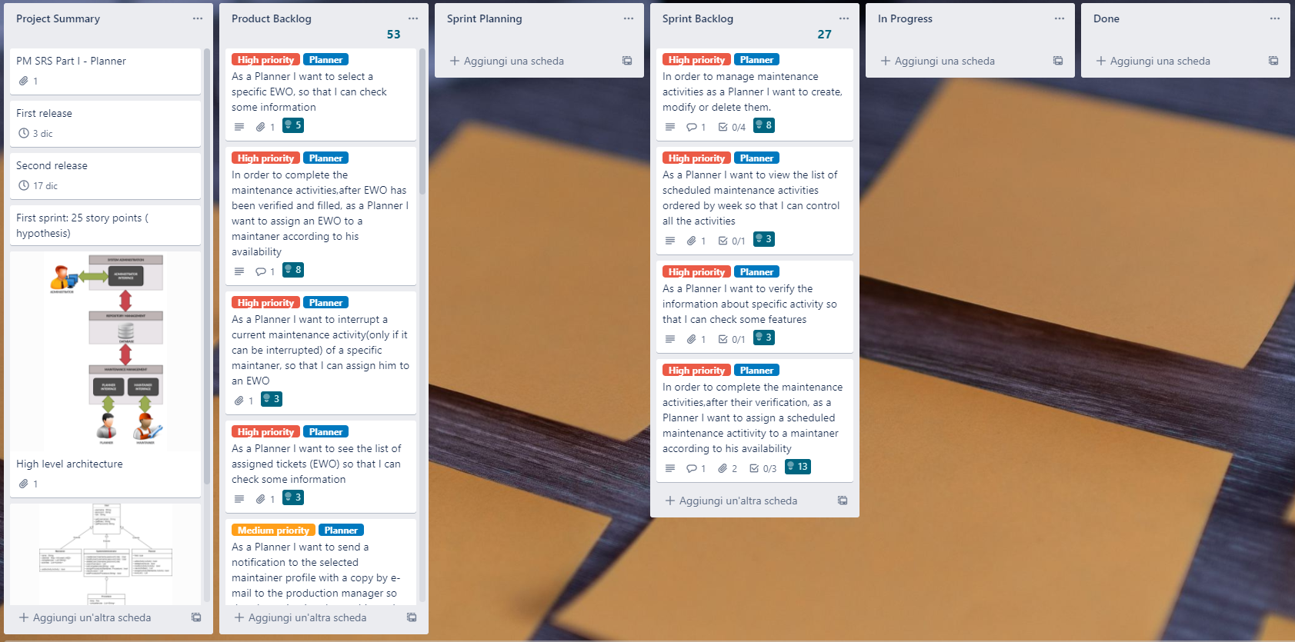
TRELLO
Definition of Done:
The member of the development team must implement, perform unit-test and
integration-test

Slide 5
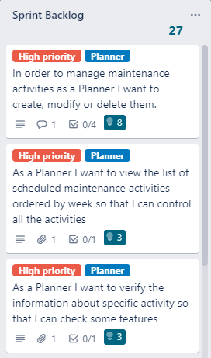
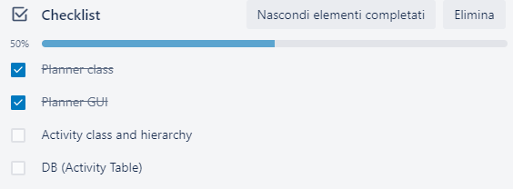
Sprint Backlog
A sprint planning was first held to create the sprint backlog.
The user stories have been decomposed into the various tasks to be carried out and the Trello checklist has been used.
After the decomposition we realized that the assigned user points were too low for the activities to be performed. So they have been modified.
The hypothesized threshold of 25 story points has been slightly exceeded, in accordance with the paradigm of aggressive programming.
Click the link to visit Trello page: https://trello.com/b/lv27Id83/project

Slide 6
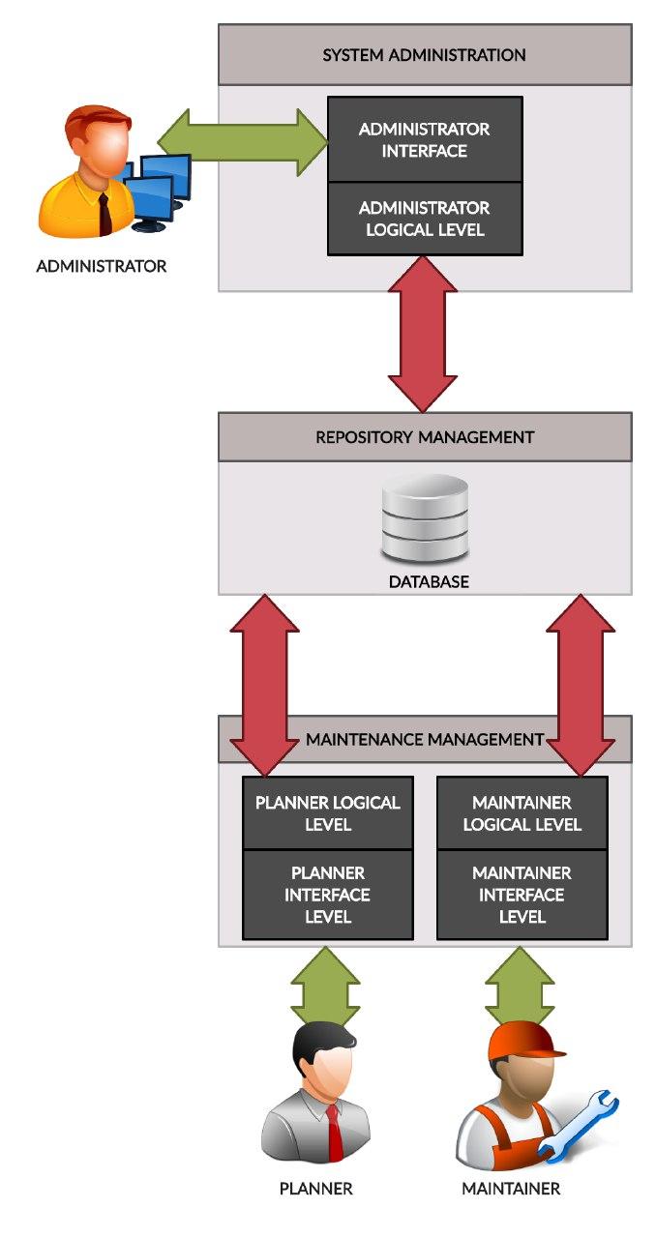
High level architecture
Analyzing the specifications we felt that it could be used a shared repository architecture.
Shared Repository
Components keep their data in a central
repository (e.g. DBMS)
Advantages:
• Easy sharing of the data
• Centralized management (backup, security,…)
Disadvantages:
• Data model must be agreed from the start
• Difficult to change the data model
• Difficult to limit interdependencies
• Workload bottlenecks

Slide 7
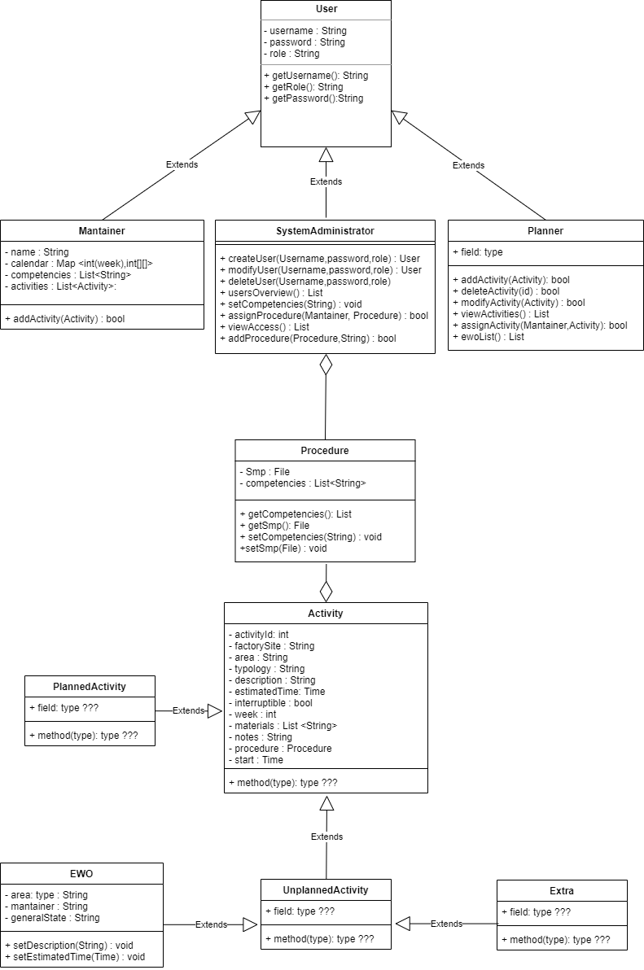
UML v1.0

Slide 8
GRAZIE
PER
L’ATTENZIONE

